Slide 1

Chatbots

Slide 2
Chatbots (Live demos)
https://chat.kuki.ai/
https://www.cleverbot.com/
http://www.jabberwacky.com/
https://www.drift.com/learn/chatbot/ai-chatbots/

Slide 3
AI Chatbots or Rule-Based Chatbots
Script-bot | Smart-bot
Script bots are easy to make | Smart-bots are flexible and powerful
Script bots work around a script which is programmed in them | Smart bots work on bigger databases and other resources directly
Mostly they are free and are easy to integrate to a messaging platform | Smart bots learn with more data
No or little language processing skills | Coding is required to take this up on board
Limited functionality | Wide functionality

Slide 4
Why AI based chatbots?
Sentiment Analysis – AI bots can comb through massive data sets to identify customer complaints, reviews, and mentions across multiple touchpoints.
Understanding Behavioral Patterns – Here, artificial intelligence bots can be used to help brands identify patterns humans might not detect.
Learning and Adapting to User Preferences – For example, if you want to offer customers a personalized solution, such as saving preferences, mirroring language, delivering customized content or offers automatically with chatbot AI.

Slide 5
Basic concepts of NLP

Slide 6
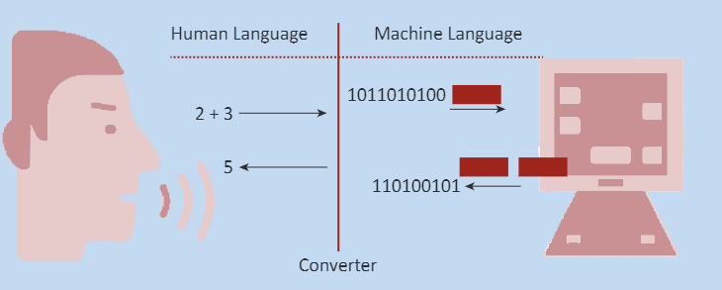
Human Language VS Computer Language

Slide 7
Language can be defined as a system of spoken, manual, or written symbols that human beings use to express themselves, their identity, imagination, and emotions.
Programming languages revolve around the same principle of communication. They were created by humans as a system of symbols and rules used to communicate a set of instructions to a machine/computer.

Slide 8
Similarities
We already got this from the previous paragraph, but let’s repeat it again: the main function of languages, be it Python or Hindi, is communication.
Another important feature that they have in common is structure. Two of the main concepts in linguistics are semantics and syntax.
Semantics refers to the meaning of a certain word, or rather an information connected to a certain concept
Syntax, on the other hand, is a set of rules that tell us how to arrange and combine words and phrases.

Slide 9
Differences
Context: Same words can have multiple meanings in human language while that is not possible in computer language
Example: I saw a saw that could not saw.

Slide 10
NLP terms:
Text Normalization:
Sentence Segmentation
Word Tokenization
Lemmatization
Stemming
Stopwords removal
Converting to common case

Slide 11
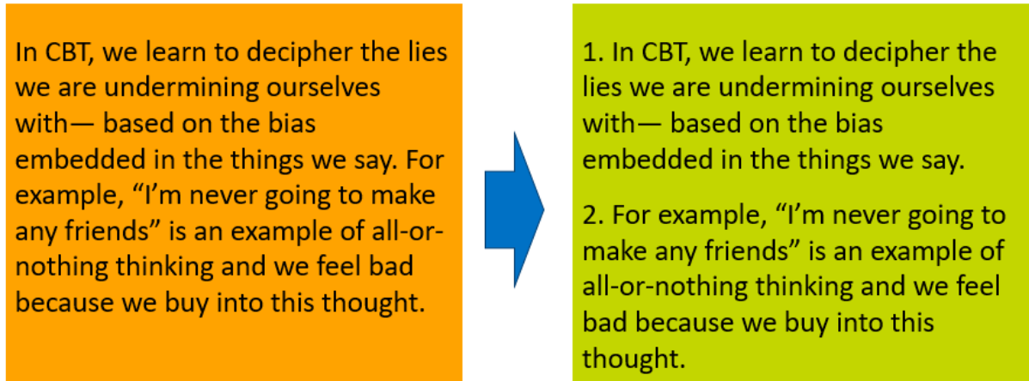
Sentence Segmentation
Under sentence segmentation, the whole corpus is divided into sentences.
Each sentence is taken as a different data so now the whole corpus gets reduced to sentences.

Slide 12
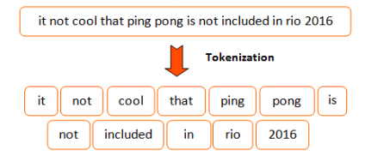
Tokenization
Tokens is a term used for any word or number or special character occurring in a sentence.
Under tokenisation, every word, number and special character is considered separately and each of them is now a separate token.

Slide 13
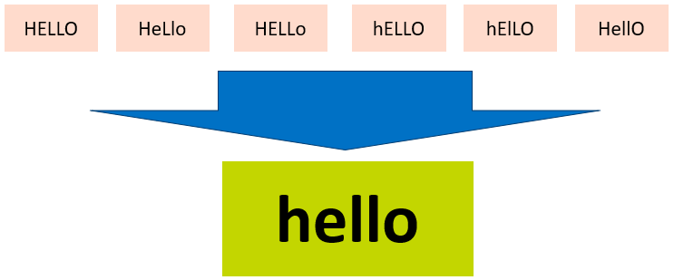
Converting text to a common case
After the stopwords removal, we convert the whole text into a similar case, preferably lower case.
This ensures that the case-sensitivity of the machine does not consider same words as different just because of different cases.

Slide 14
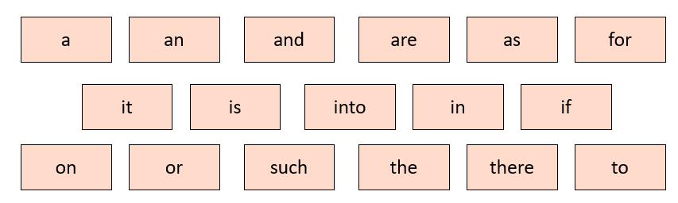
Removing Stopwords, Special Characters and Numbers
In this step, the tokens which are not necessary are removed from the token list.
Stopwords are the words which occur very frequently in the corpus but do not add any value to it.

Slide 15
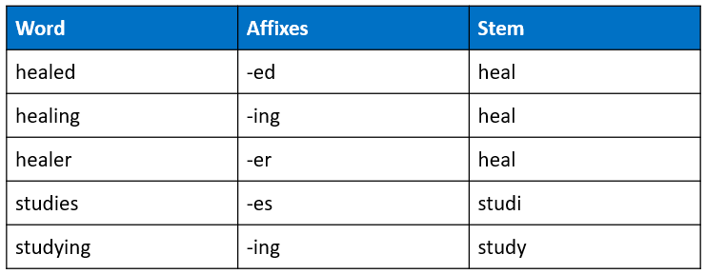
Stemming
Stemming is the process in which the affixes of words are removed and the words are converted to their base form.
Note that in stemming, the stemmed words (words which are we get after removing the affixes) might not be meaningful.

Slide 16
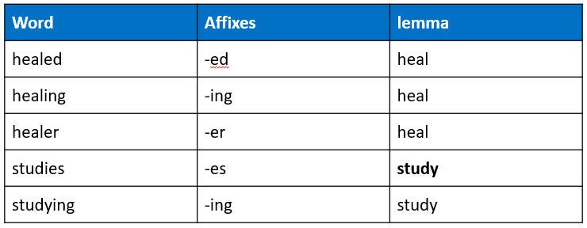
Lemmatization
Stemming and lemmatization both are alternative processes to each other as the role of both the processes is same – removal of affixes.
But the difference between both of them is that in lemmatization, the word we get after affix removal (also known as lemma) is a meaningful one.

Slide 17
